Slide 1
Ebuka John 26044631 Project Work Presentation
Masters of Science, University of Lincoln

Slide 2
An improved Q- Learning Cloud Based Solution for Time Dependent Vehicle Routing Problem using Markov Decision Process
Theses

Slide 3
Outline
Abstract
Definition of terms VRP, Time dependent VRP (TDVRP), Average flow rate, Episodes, Cloud
Markov Decision Process (MDP)
Q-Learning Algorithm
Microsoft Azure Machine Learning Studio
Jupyter Notebook
Interpretation of Results

Slide 4
Abstract
Vehicle routing problem (VRP) is the most important issue in logistics and transportation, so it is expected to be around as long as commerce and transportation subsist. Time dependent vehicle routing problem (TDVRP) is arguably the most popular variant of VRP. The interest of a TDVRP solver is to determine the best possible routing options under certain static or dynamic conditions. This project work attempts to model TDVRP with Markov Decision Process (MDP) and adapt an improved Q-Learning algorithm to optimize the choices presented in the MDP model using a cloud infrastructure. The model represents the road network as simple node points forming a network, distance matrix as connections between any two nodes and average flow rate matrix as a measure of congestion along any two roads The model factors in congestion which is the bane of most TDVRPs. Additionally, the reward scheme and action sets are developed and used as parameters in the learning algorithm. The results from the model show that the higher the number of learning agents the faster the VRP solution, that is more learning agents solve the routing problem quickly and recommend a fast-moving route to the vehicle in transit.

Slide 5
Definition of terms
VRP: It involves finding optimal route for vehicles
Time dependent VRP (TDVRP): VRP that considers delay or traffic congestion when proposing a solution
Average flow rate (AFR): no of vehicles/hour
Episodes: No of times a solution can be refined
Cloud: Delivering computing services over a public or corporate network. Risks and cost are shared by users.

Slide 6
Markov Decision Process(MDP)
It is a feedback compliant system that ensures every action is rewarded and the reward helps the learning agent to take smarter decisions as the learning activity progresses.
MDP is usually defined as a 4-tuple (S, A, P, R).
where:
S = {S₁, S₂, ..., S_{n}} is a finite set of states.
A = {A₁, A₂, ..., A_{m}} is a finite set of actions.
P is a Markovian state transition model or action-state mapping function — P (S, A, S_) is the probability of making a transition from state S to S_ by taking action A, P (S −A→ S_) and,
R is a reward (or cost) function — R (S, A, S_) is the reward for the transition S −A→ S_.

Slide 7
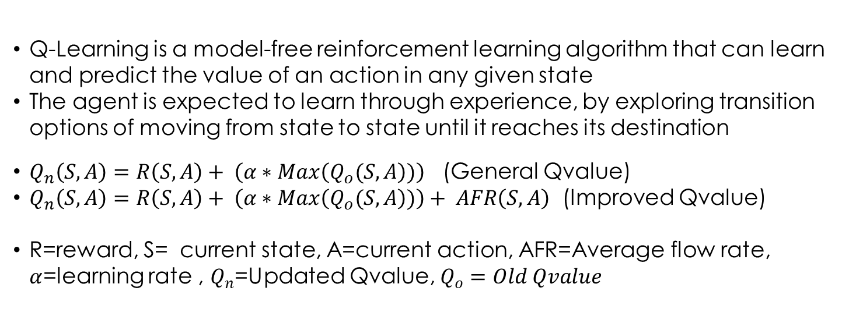
Q-Learning (Definition & Formula)
Q-Learning is a model-free reinforcement learning algorithm that can learn and predict the value of an action in any given state
The agent is expected to learn through experience, by exploring transition options of moving from state to state until it reaches its destination
$Q_{n}\left(S,A\right)=R\left(S,A\right)+ \left(α∗Max\left(Q_{o}(S,A\right))\right)$ (General Qvalue)
$Q_{n}\left(S,A\right)=R\left(S,A\right)+ \left(α∗Max\left(Q_{o}(S,A\right))\right)+ AFR\left(S,A\right)$ (Improved Qvalue)
R=reward, S= current state, A=current action, AFR=Average flow rate, $α$=learning rate , $Q_{n}$=Updated Qvalue, $Q_{o}=Old Qvalue$

Slide 8
Q-Learning Algorithm
Initialize Q-Table values for all state S to zero
Get Q-value and Do Policy Iteration
Get Reward and Move to New State
Compute and Update Q-Value
Repeat previous steps until goal is reached i.e., arrived at the destination.

Slide 9
Azure Machine Learning Studio
Azure Machine Learning Studio is a GUI based integrated development environment used for developing and operationalizing AI and Machine Learning (ML) workflows on Microsoft Azure.
Setting up Cloud Environment for Implementation

Slide 10
Azure Machine Learning Studio (contd)
Go to Azure and login with your credentials
Go to Azure Machine Learning
Create a Resource group (container for all the resources needed)
Create a Workspace (Workbench for all the pipeline components)
From your Workspace lunch Azure Machine Learning Studio
Create a folder under your account dubbed “MastersProject”
Create a sub folder under “MastersProject” dubbed “src”
Create a Jupyter file “QLearning_Runs”.ipynb”
Go to top right corner and add Azure compute instance
Associate the Azure compute instance with the workspace
Select target runtime environment e.g. Python 3.10 SDK, AzureML etc.
Write and execute your codes

Slide 11
Jupyter Notebook
Jupyter notebook is a web-based code editor that supports all the capabilities to run python codes, plugins, neat styling, customization, data explorational analysis and data format transformations and integrates seamlessly with Azure Machine Learning Studio.
The interface is intuitive and easy to navigate.

Slide 12
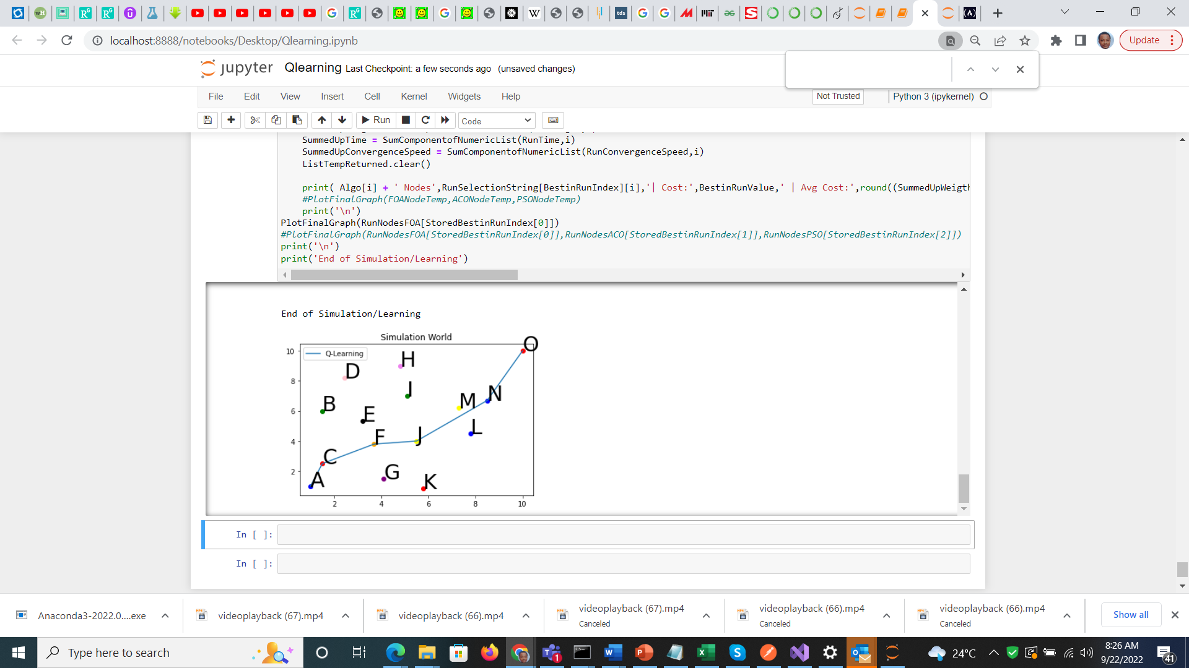
Interpretation of Results (1)
# 1 | No of Episodes | Exec Time | Avg Q-Cost
1 | 1 | 0.00981 | 45.50
2 | 2 | 0.00943 | 46.40
3 | 3 | 0.00900 | 45.50
4 | 5 | 0.00896 | 44.80
5 | 10 | 0.00840 | 47.00
# 2 | No of Episodes | Exec Time | Avg Q-Cost
1 | 1 | 0.00802 | 20.50
2 | 2 | 0.00740 | 19.40
3 | 3 | 0.00601 | 18.50
4 | 5 | 0.00550 | 19.80
5 | 10 | 0.00402 | 20.00
#3 | No of Episodes | Exec Time | Avg Q-Cost
1 | 1 | 0.00202 | 10.40
2 | 2 | 0.00200 | 8.50
3 | 3 | 0.00150 | 10.50
4 | 5 | 0.00120 | 8.40
5 | 10 | 0.00082 | 10.40

Slide 13
Interpretation of Results (2)

Slide 14
Interpretation of Results (3)
There is a noticeable trend among the tables; the execution time seems to reduce as the number of learning agent increases, because the higher the number of learning agents the quicker the task of making decision to reaching the goal. Usually, the task of reaching the destination is supposed to be performed by a single learning agent but by increasing the number of agents, the task is divided, and the best possible route suggested by the learning agents is combined and prescribed as the path to follow for the vehicle trying to solve VRP problem. More so, the average Q-cost did not change appreciably with higher number of episodes but drops drastically with higher number of learning agents which is evident among the tables.

